Slide 1
History of Evolutionary Thought
(these topics revisited through the course)
Before Darwin (pre 1859)
Darwin (1859)
Theories after Darwin (early 1900’s)
The evolutionary synthesis (1930’s, 40’s)
Biology since the synthesis (1950 on)

Slide 2
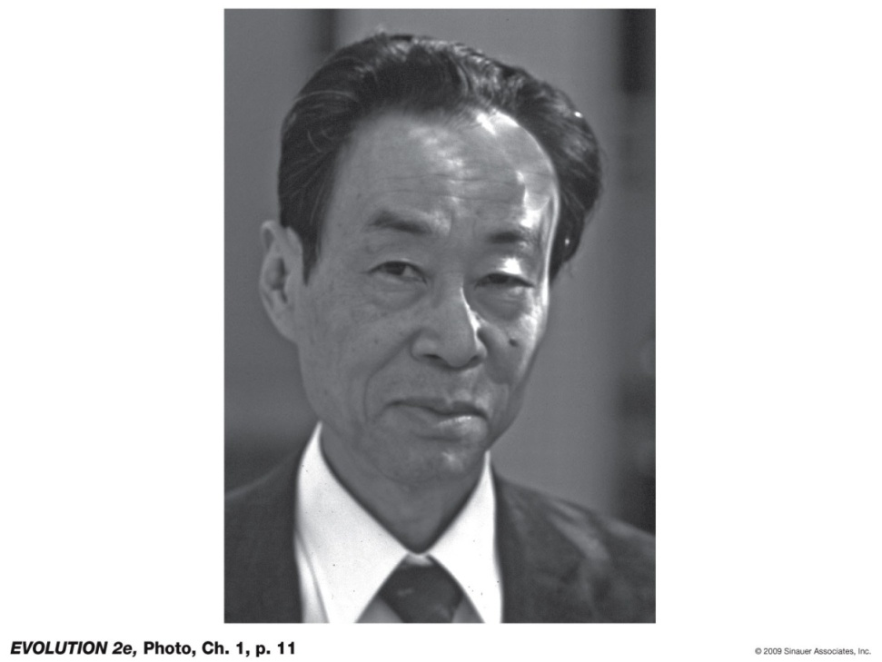
Motoo Kimura and the Neutral Theory of Molecular Evolution
Natural selection requires phenotypic variation to act upon
But many genetic changes cause no phenotypic change (do not produce phenotypic variation)
Led to the hypothesis that
most of the evolution of DNA sequences occurs by genetic drift, rather than natural selection
Notes:
Evolution-2e-Photo-01-p011.jpg

Slide 3
The Genetic Code (DNA)
“Wobble” position and DNA nucleotide substitutions which do NOT change the protein (amino acid)
TTT | Phe |  | TCT | Ser |  | TAT | Tyr |  | TGT | Cys
TTC | Phe |  | TCC | Ser |  | TAC | Tyr |  | TGC | Cys
TTA | Leu |  | TCA | Ser |  | TAA | STOP |  | TGA | STOP
TTG | Leu |  | TCG | Ser |  | TAG | STOP |  | TGG | Trp
CTT | Leu |  | CCT | Pro |  | CAT | His |  | CGT | Arg
CTC | Leu |  | CCC | Pro |  | CAC | His |  | CGC | Arg
CTA | Leu |  | CCA | Pro |  | CAA | Gln |  | CGA | Arg
CTG | Leu |  | CCG | Pro |  | CAG | Gln |  | CGG | Arg
ATT | Ile |  | ACT | Thr |  | AAT | Asn |  | AGT | Ser
ATC | Ile |  | ACC | Thr |  | AAC | Asn |  | AGC | Ser
ATA | Ile |  | ACA | Thr |  | AAA | Lys |  | AGA | Arg
ATG | Met* |  | ACG | Thr |  | AAG | Lys |  | AGG | Arg
GTT | Val |  | GCT | Ala |  | GAT | Asp |  | GGT | Gly
GTC | Val |  | GCC | Ala |  | GAC | Asp |  | GGC | Gly
GTA | Val |  | GCA | Ala |  | GAA | Glu |  | GGA | Gly
GTG | Val |  | GCG | Ala |  | GAG | Glu |  | GGG | Gly

Slide 4

Motoo Kimura and the Neutral Theory of Molecular Evolution
This hypothesis holds that
most of the evolution of DNA sequences occurs by genetic drift, rather than natural selection
But, it provides a foundation for detecting natural selection on DNA sequences
Notes:
Evolution-2e-Photo-01-p011.jpg

Slide 5
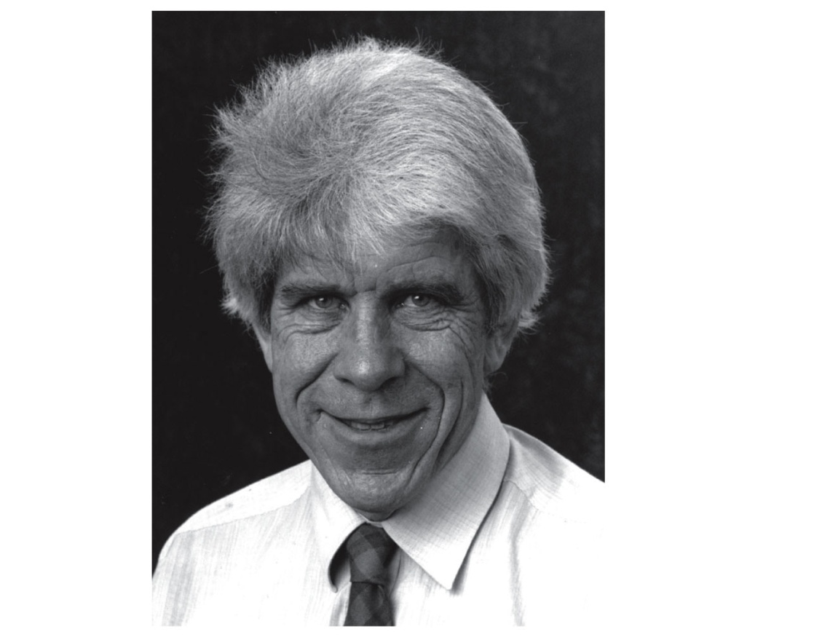
William D. Hamilton, Robert Trivers, and Social Theory
Cooperation – Kin selection (explains confusing altruistic behaviors and eusociality)
Conflict – parent/offspring, sibling, male/female
Notes:
Evolution-2e-Photo-01-p012.jpg

Slide 6
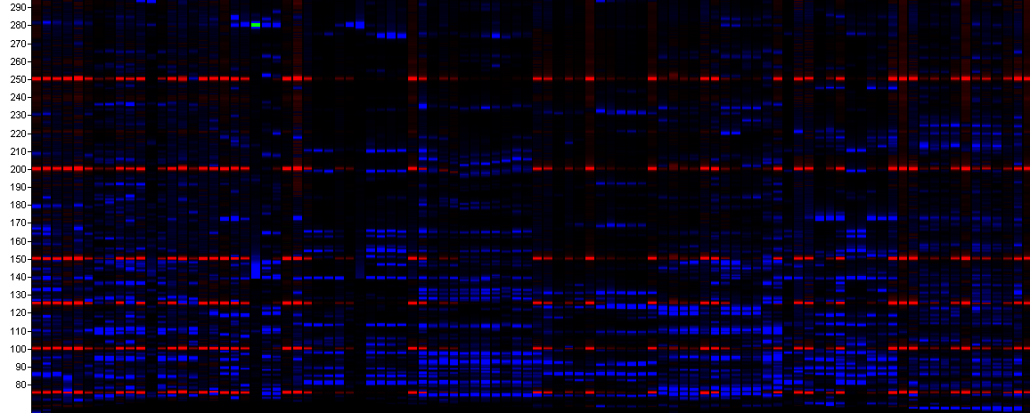
Now…. The age of genomics (a new age of INDUCTION)
new insights into the size, organization and structure of genomes
in turn, this information yields insight into the causes and consequences of evolution

Slide 7
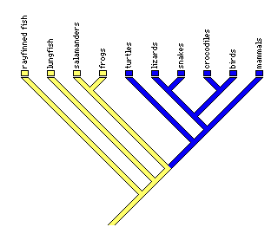
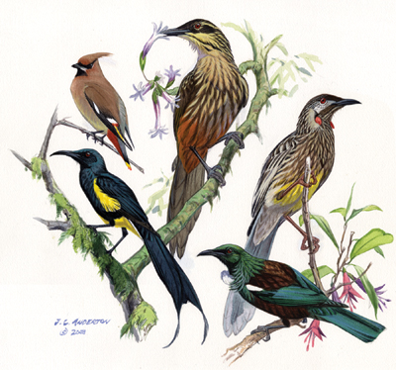
Taxonomy and Systematics

Slide 8
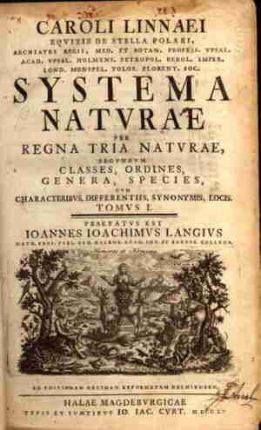
Taxonomy and Systematics
1) Some terminology
2) Taxonomy: concepts and history
3) Systematics and phylogenetic trees
4) Methods of inferring phylogenies

Slide 9
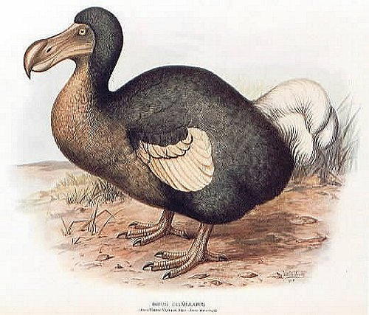
Taxonomy and Systematics
Some terminology:
Taxonomy – the science of describing, naming, and classifying organisms.
Taxon (plural = taxa) – a unit of taxonomic classification
Systematics – the study of biological diversity and the evolutionary relationships among organisms.
Testing hypotheses about which groups have descended from a common ancestor
Extinct – no longer present
Extant – taxa that exist today

Slide 10
Terminology (continued):
Phylogeny – the history of descent of a group of taxa from their common ancestors. (phylogenetics = study of phylogenies).
The diagrams that depict phylogenies are phylogenetic trees. A phylogenetic tree is a systematic hypothesis.

Slide 11
Taxonomy and Systematics
1) Some terminology
2) Taxonomy: concepts and history
3) Systematics and phylogenetic trees
4) Methods of inferring phylogenies

Slide 12
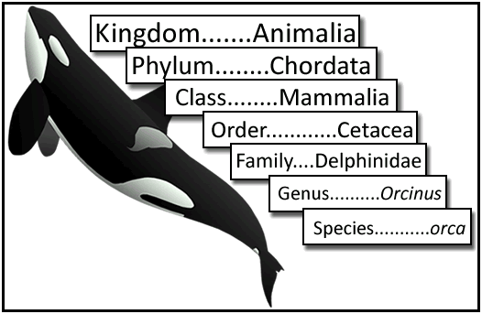
Taxonomy
Used to organize groups of species into progressively smaller hierarchical groups.
Originally Kingdom was the most inclusive taxonomic group

Slide 13
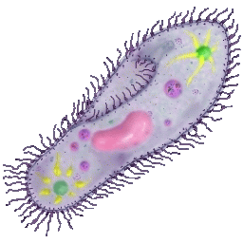
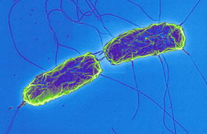
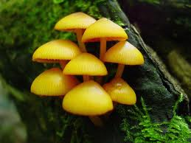
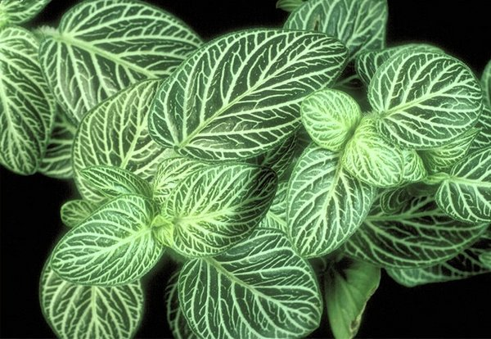

Taxonomy (continued)
“Five kingdom” system was used for many years (even when I was a kid!)
Monera
Protista
Fungi
Plantae
Animalia

Slide 14
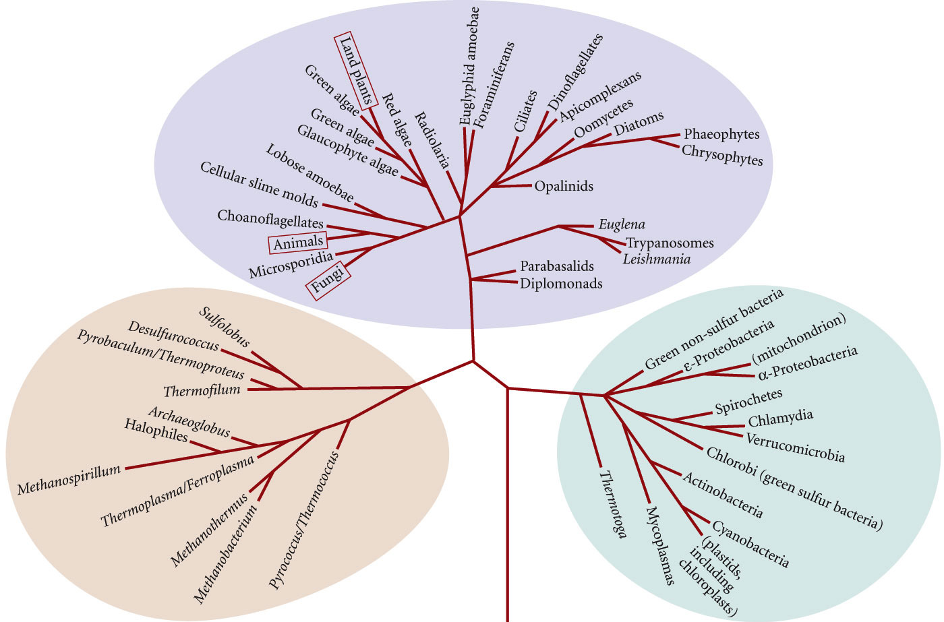
Taxonomy (continued)
“Five kingdom” system was used for many years (even when I was a kid!)
Three domain system:
Eukarya
Archaea Bacteria

Slide 15
Taxonomy (continued)
One purpose of taxonomy is to name species
Modern species taxonomy started with Carl Linnaeus.
First introduced binomial nomenclature in his 1753 “Species Plantarum” and 1758 “Systema Naturae” editions.

Slide 16
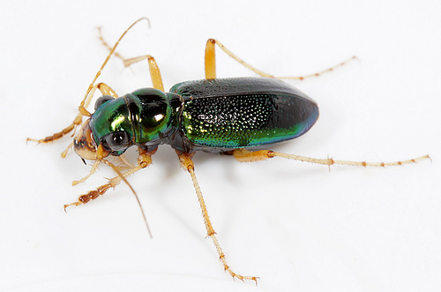
Taxonomy (continued)
One purpose of taxonomy is to name species
Modern species taxonomy started with Carl Linnaeus.
First introduced binomial nomenclature in his 1753 “Species Plantarum” and 1758 “Systema Naturae” editions.
Each species name has two parts:
Megacephala virginica

Slide 17
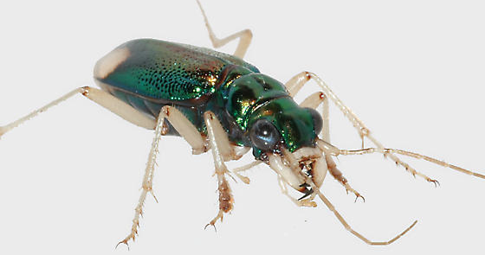
Taxonomy (continued)
One purpose of taxonomy is to name species
Modern species taxonomy started with Carl Linnaeus.
First introduced binomial nomenclature in his 1753 “Species Plantarum” and 1758 “Systema Naturae” editions.
Each species name has two parts:
Megacephala virginica
Megacephala carolina

Slide 18
Taxonomy and Systematics
1) Some terminology
2) Taxonomy: concepts and history
3) Systematics and phylogenetic trees
4) Methods of inferring phylogenies

Slide 19

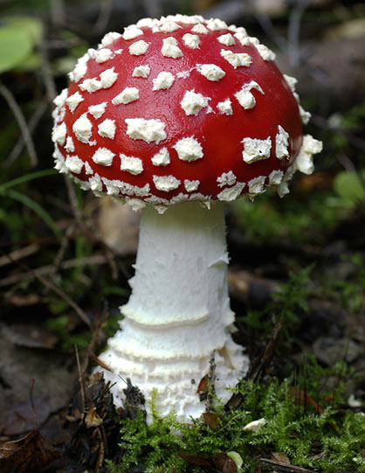
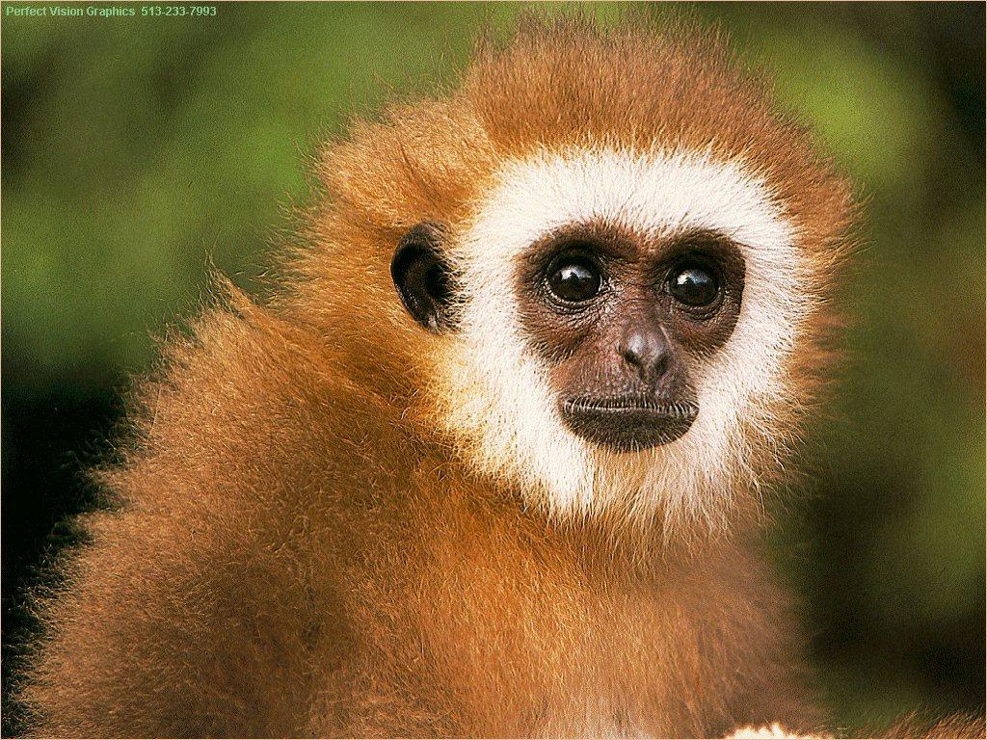
How can studying systematics possibly be interesting?
Relatedness? The resulting pathway is interesting of itself (who is most closely related to who? Are dogs more closely related to cats or to pigs?) Sometimes results are surprising…

Slide 20
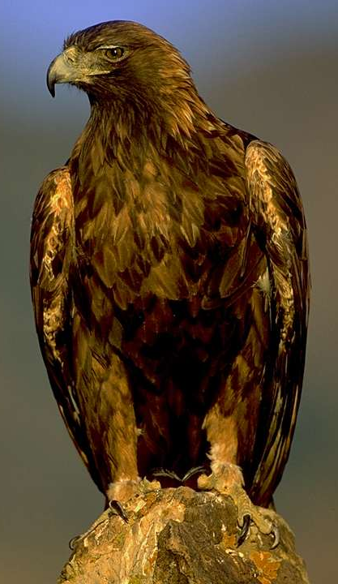
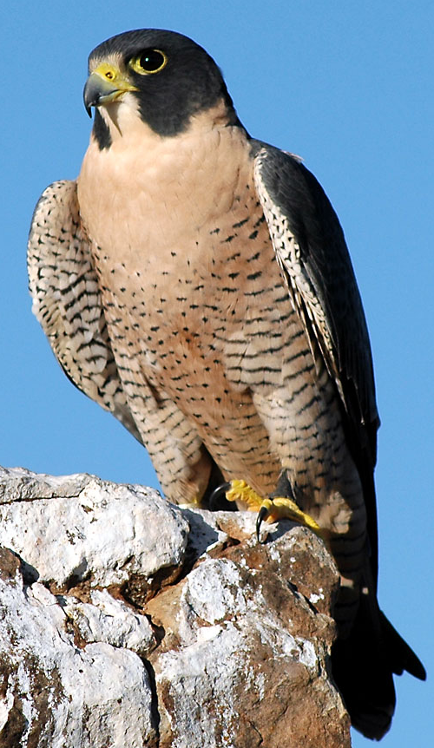
How can studying systematics possibly be interesting?

Slide 21
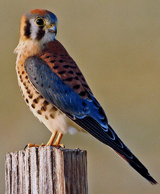
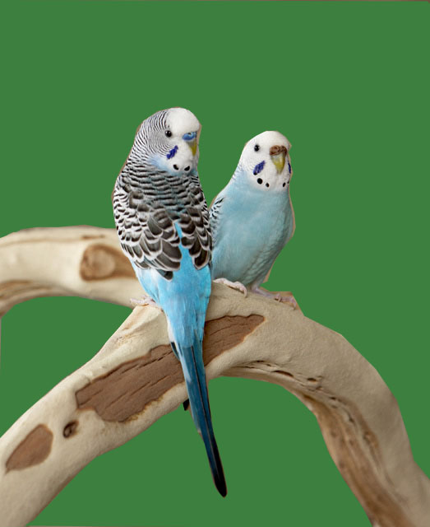
How can studying systematics possibly be interesting?

Slide 22
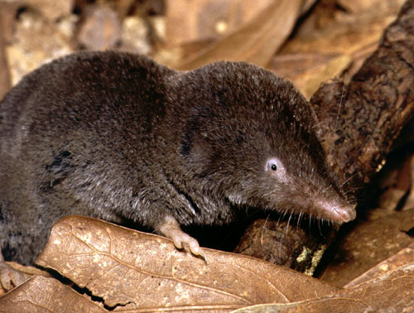
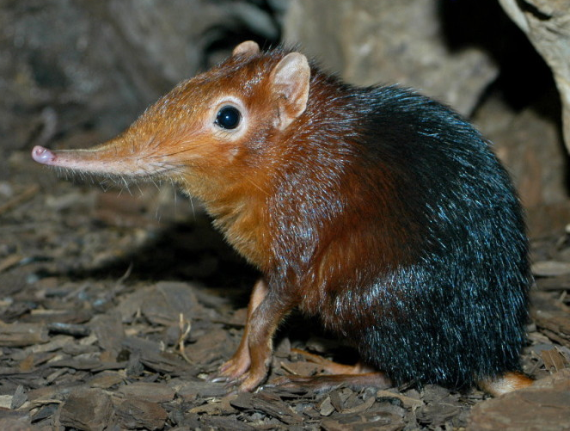
How can studying systematics possibly be interesting?

Slide 23
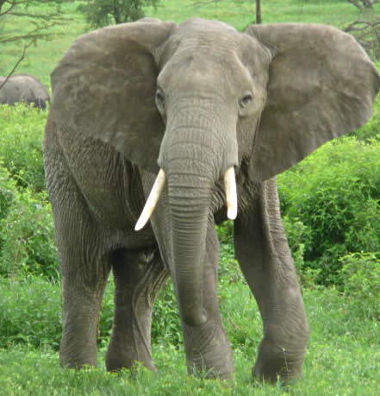
How can studying systematics possibly be interesting?

Slide 24
How can studying systematics possibly be interesting?
Relatedness? The resulting pathway is interesting of itself (who is most closely related to who? Are dogs more closely related to cats or to pigs?) Sometimes results are surprising…
Trait evolution? Phylogenetic trees provide a foundation for understanding many aspects of evolutionary history, such as the pathways by which various characters evolved (how many times did wings evolve?)
Cutting edge technology? Use of molecular data, including whole genome sequences
Detective work? Unlike some aspects of evolution, we cannot often directly observe evolutionary history. Instead, we must infer it using phylogenetic methods, like Sherlock Holmes reconstructing the history of a crime…
Notes:
Three-taxon statement

Slide 25
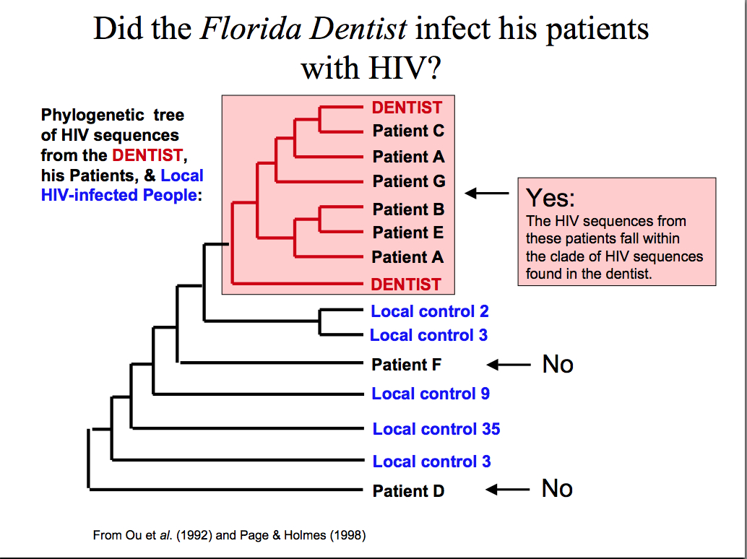

Slide 26
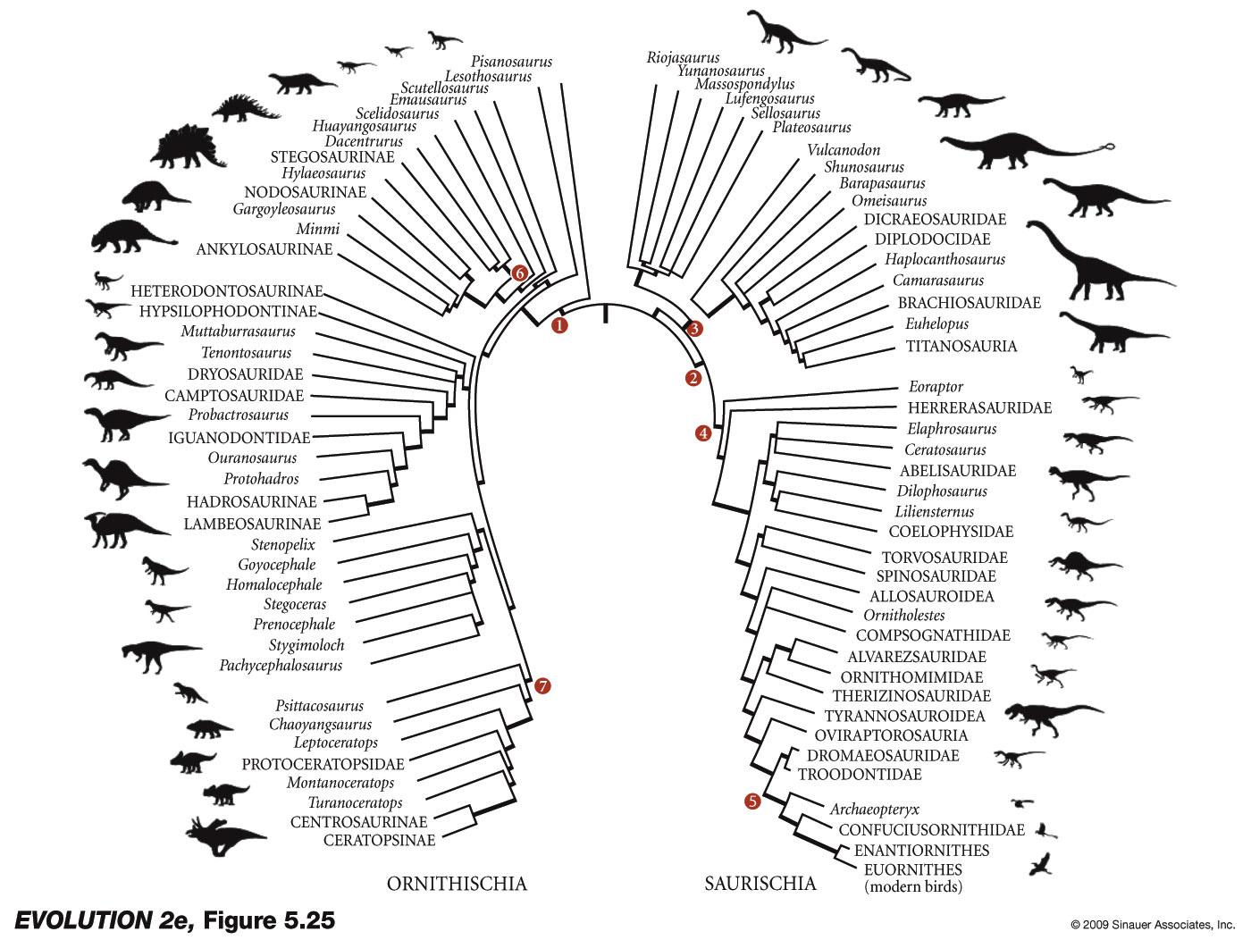
There are many ways to represent phylogenetic trees…

Slide 27
There are many ways to represent phylogenetic trees…
Rotating the branches does not change the relationships!
A
C
B
=
B
C
A
D
D

Slide 28
Phylogenetic tree terminology
Root: the common ancestor of all taxa
Node: a branchpoint in a tree
Clade: a group of two or more taxa that includes both their common ancestor and all their descendents
Node
Root

Slide 29
Phylogenetic tree terminology
Root: the common ancestor of all taxa
Node: a branchpoint in a tree
Clade: a group of two or more taxa that includes both their common ancestor and all their descendents
Node
Clade
Root

Slide 30
Phylogenetic tree terminology
Root: the common ancestor of all taxa
Node: a branchpoint in a tree
Clade: a group of two or more taxa that includes both their common ancestor and all their descendents
Node
Root
Clade

Slide 31
Phylogenetic tree terminology
Monophyletic group: A taxon that is a clade. A group that includes ALL of the descendants of a common ancestor.
Monophyletic

Slide 32
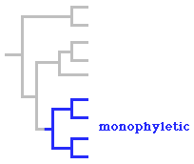
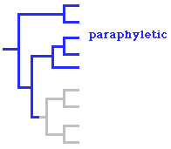
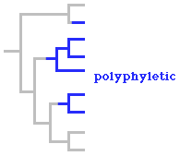
Phylogenetic tree terminology
Paraphyletic group: A group that includes some, but not all, of the descendants of a common ancestor.
Polyphyletic group: A group that consists of members of multiple evolutionary lineages, but not not include the most recent common ancestor and all of its descendants.

Slide 33

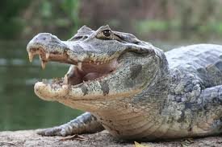
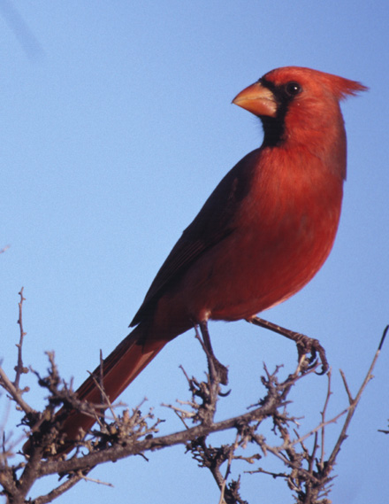
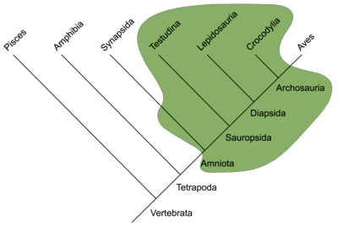
Phylogenetic tree terminology
Paraphyletic group: A group that includes some, but not all, of the descendants of a common ancestor..

Slide 34
Phylogenetic tree terminology
Paraphyletic group: A group that includes some, but not all, of the descendants of a common ancestor.
Polyphyletic group: A group that consists of members of multiple evolutionary lineages, but not not include the most recent common ancestor and all of its descendants.

Slide 35
Taxonomy and Systematics
1) Some terminology
2) Taxonomy: concepts and history
3) Systematics and phylogenetic trees
4) Methods of inferring phylogenies

Slide 36
How is a phylogenetic tree actually built?
One consideration is ‘shared characters’
character = a feature or trait (e.g. color of snail shell)
character states = one of the variant conditions of a character (e.g. brown or yellow shell; A or T at a nucleotide position)
ancestral state = state found in common ancestor
derived state = state that has evolved from the ancestral state
outgroup = a taxon that is closely related to the study group. comparisons of character states can inform as to which are ancestral and derived.

Slide 37
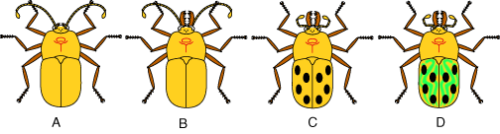
Outgroup comparison
outgroup

Slide 38
Outgroup comparison
outgroup
Character Character States
1. Jaw size 0 = small, 1 = large
2. Antennae type 0 = long, 1 = small
3. Spots 0 = absent, 1 = present
4. Stripes 0 = absent, 1 = present

Slide 39
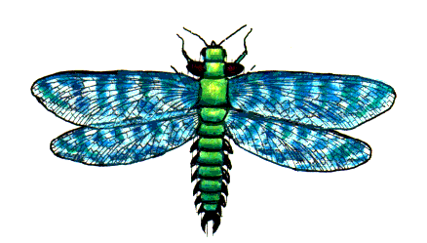
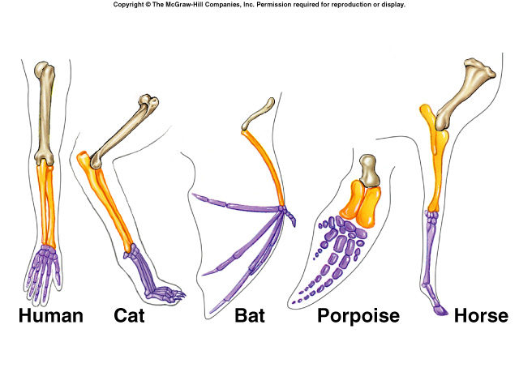
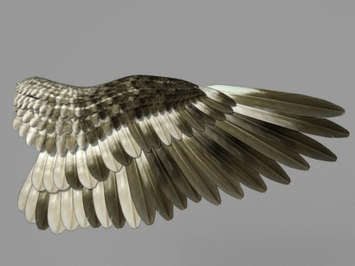
Now we know the ‘tree terms’, but how is a phylogenetic tree actually built?
One consideration is ‘shared characters’
homology = same character state found in different taxa due to shared common ancestry
analogy (homoplasy) = same character state found in different taxa due to convergent evolution or reversal

Slide 40
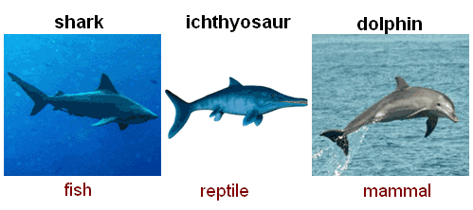
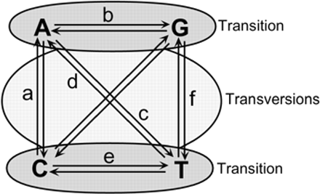
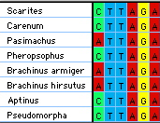
analogy (homoplasy) = same character state found in different taxa due to convergent evolution or reversal

Slide 41
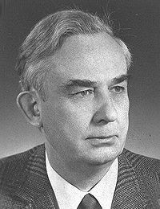
Cladistic approach
Create phylogenetic trees based on shared character states
Only certain types of character data can give useful information about relationships
Symplesiomorphies are shared ancestral characters. They aren’t phylogenetically informative
Autapomorphies are unique derived characters. This type of character is distinctive for a taxon and it enables us to identify that taxon, but autapomorphies also tell us nothing about a taxon’s relationship to other groups
Willi Hennig

Slide 42
Cladistic approach (cont.)
Synapomorphies are shared derived characters. These are the only characters that really help us to resolve relationships (i.e. are phylogenetically informative).
Willi Hennig

Slide 43
Maximum parsimony – the principle, dating back at least the 14th century, that the simplest explanation, requiring the fewest undocumented assumptions, should be preferred over more complicated hypotheses that require more assumptions
When we create phylogeny using maximum parsimony, we choose the tree that involves the smallest number of character changes. We are basing this on the assumption that most shared derived characters are due to common ancestry, not convergence.

Slide 44
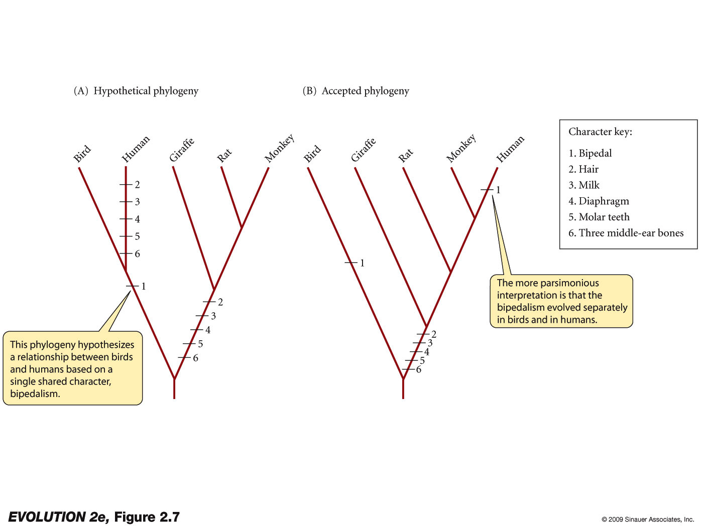
When we create phylogeny using “maximum parsimony”, we choose the tree that involves the smallest number of character changes.

Slide 45
When we create phylogeny using “maximum parsimony”, we choose the tree that involves the smallest number of character changes.

Slide 46
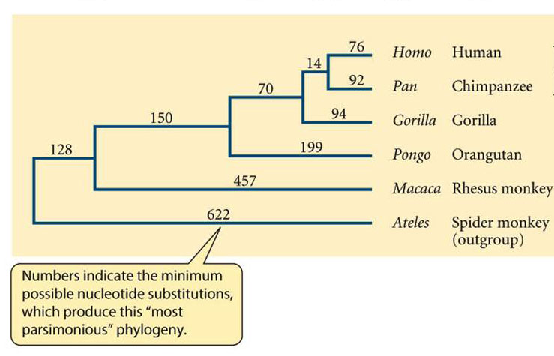
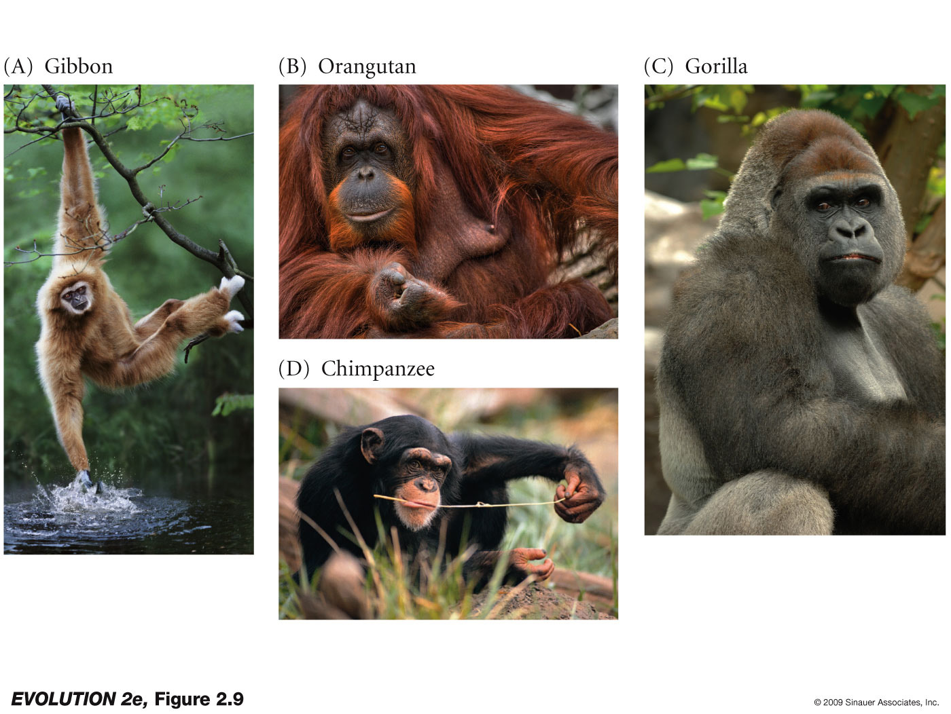
An example
using molecular
(DNA) data

Slide 47
One more time…
When we create phylogeny using maximum parsimony, we choose the tree that involves the smallest number of character changes. We are basing this on the assumption that most shared derived characters are due to common ancestry, not convergence.
The tree that shows the smallest number of evolutionary changes is the most likely tree according to the principle of maximum parsimony

Slide 48
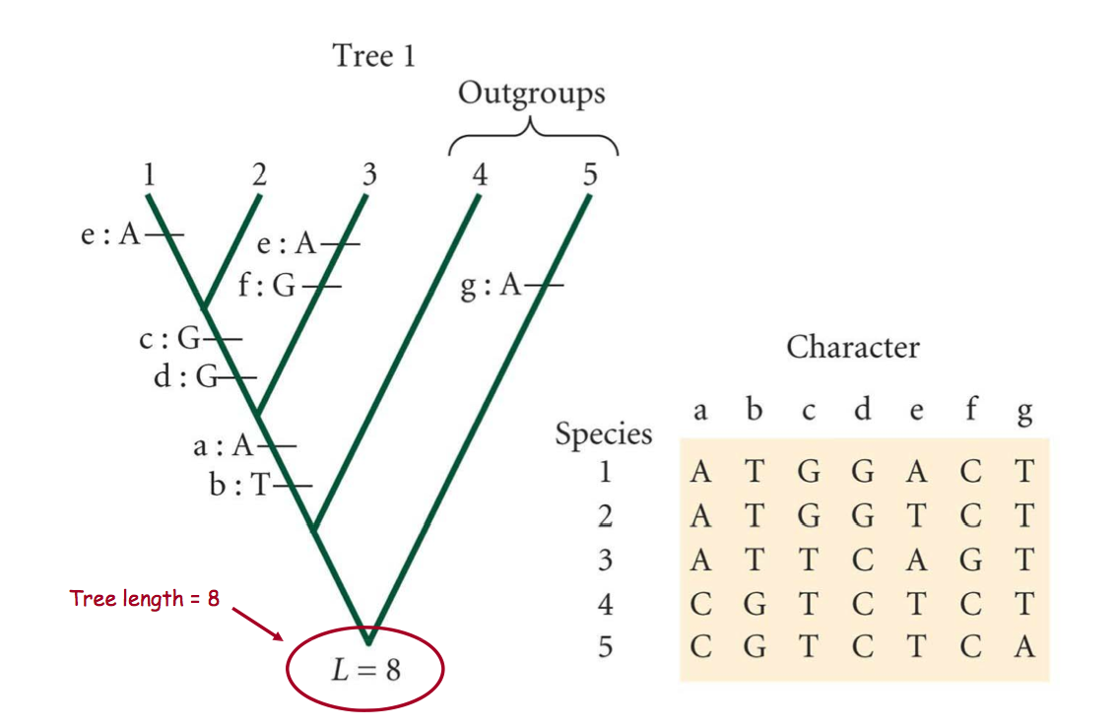
Another example of cladistics (maximum parsimony)

Slide 49
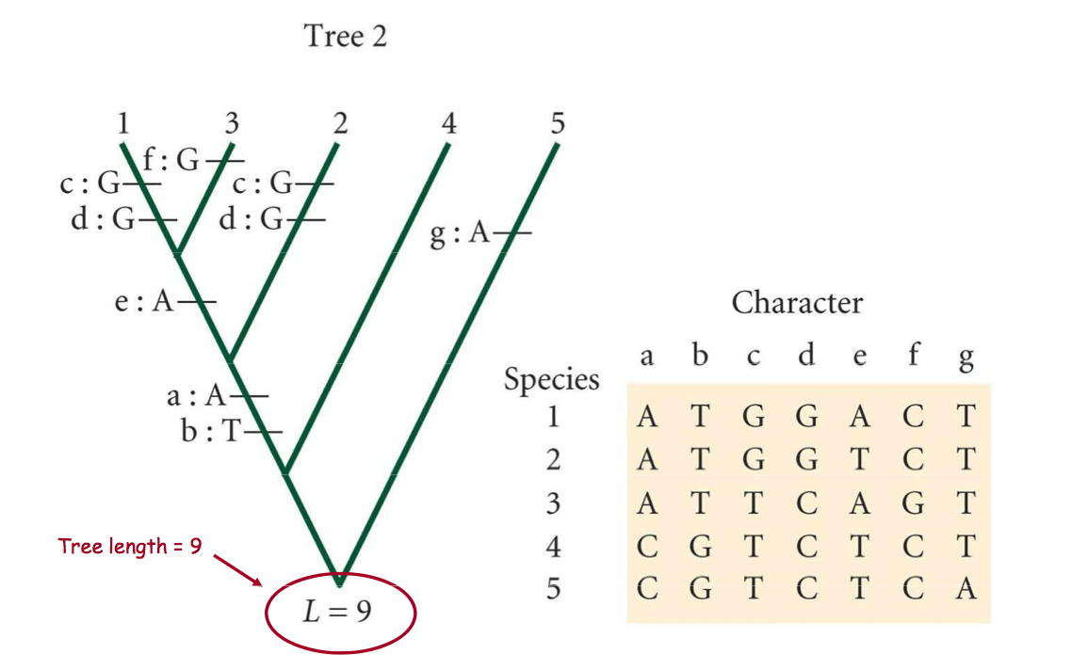
Another example of cladistics (maximum parsimony)

Slide 50
Phylogenies are created using computers because they are so computationally intensive. Maximum parsimony is one of the least computational methods, actually.
However, there are many possible alternative relationships between taxa.
Let’s put this in perspective:
# of taxa # of possible arrangements
3 3
4 15
5 105
10 34,459,425
100 2 x 10¹⁸² (!)

Slide 51
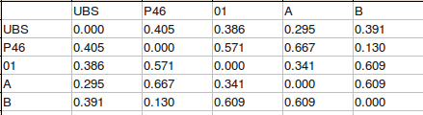
Other methods of phylogenetic analysis
Neighbor-Joining – A clustering method that is not based on characters per se, but instead finds relationships based on the percent differences between taxa (‘distance’)
Distance matrix

Slide 52
Other methods of phylogenetic analysis
Maximum Likelihood (ML) – given a specific model of evolution and a possible tree, this method calculates the likelihood of observing the data
Bayesian – maximizes the probability of observing a particular tree, given the model and the data, unlike the ML method, Bayesian analysis provides the probability of a set of different trees so that they can be compared and summarized

Slide 53
Other methods of phylogenetic analysis
Maximum Likelihood (ML) – given a specific model of evolution and a possible tree, this method calculates the likelihood of observing the data
Bayesian – maximizes the probability of observing a particular tree, given the model and the data, unlike the ML method, Bayesian analysis provides the probability of a set of different trees so that that they can be compared and summarized
These are VERY computer intensive methods!

